Slide 1
Theory of Statistics
Prof. Md. Aminul Hoque, PhD
Cell/Wap: 01715361973
E-mail: aminul@ac.ru.ac.bd

Slide 2
Analysis of Contingency Table
What is contingency Table?
In statistics, a contingency table is a type of table in a matrix format that displays the frequency distribution of the variables. They are heavily used in survey research, business intelligence, engineering, and scientific research.

Slide 3
Use/ Applications of CT
In statistics, a contingency table (also known as a cross tabulation or crosstab) is a type of table in a matrix format that displays the (multivariate) frequency distribution of the variables. They are heavily used in survey research, business intelligence, engineering, and scientific research.

Slide 4
Manifold Classification
Definition: If a population is divided into a number of mutually exclusive classes according to some given characteristic and then each class is divided by reference to some second, third, etc. characteristic, the final grouping is called a manifold classification.

Slide 5
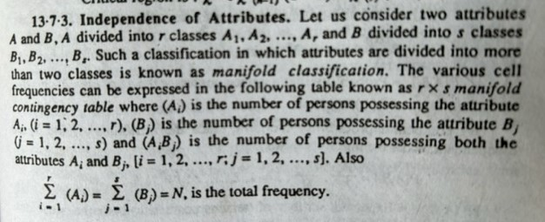

Slide 6
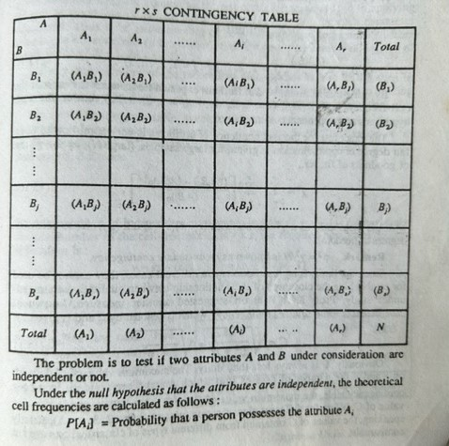

Slide 7
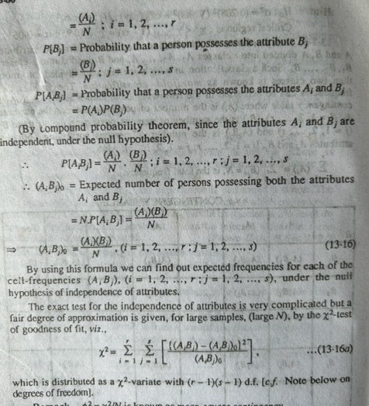

Slide 8
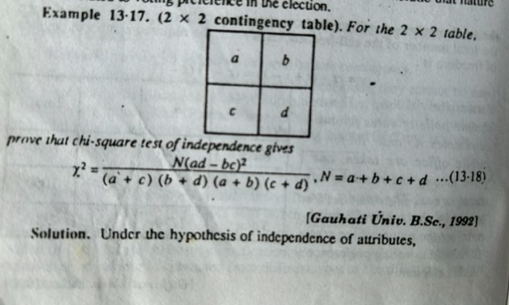

Slide 9
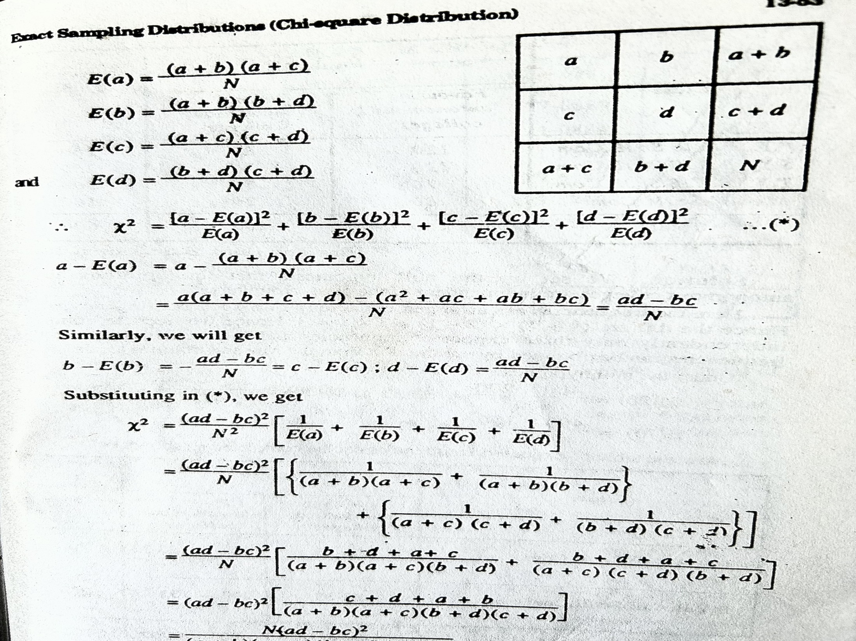

Slide 10
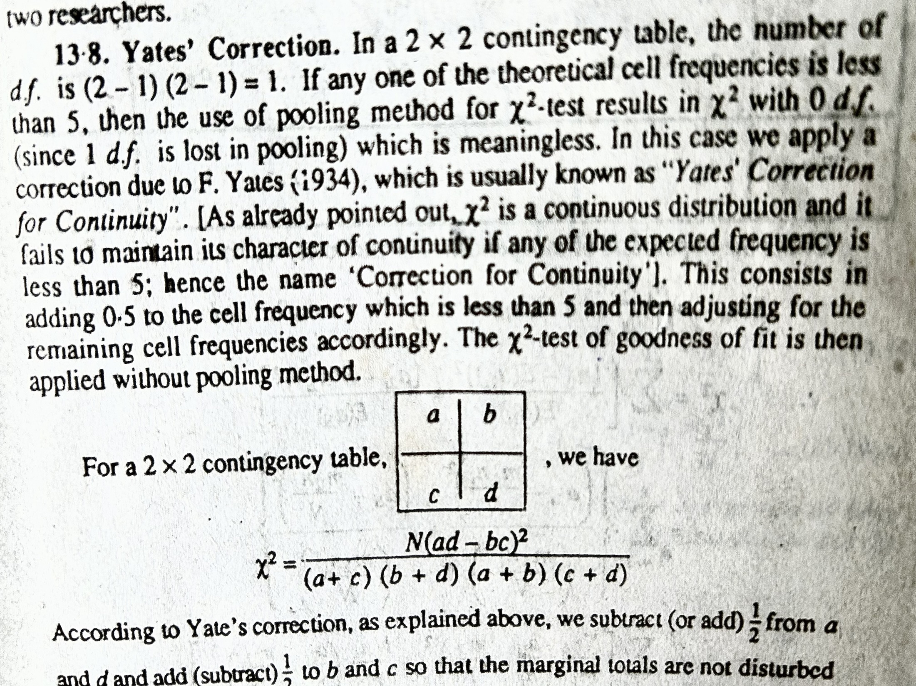

Slide 11
